Slide 1
Database System Architecture
Group:
Sony Shrestha
Aayush Paudel
Hadi El Yakhni
Iyoha Peace Osamuyi
INFO-H-417
Professor:
Mahmoud SAKR
Maxime Schoemans

Slide 2
Agenda
01
Overview
02
Data Type
03
Function
04
Index
05
Validation
06
Conclusion

Slide 3
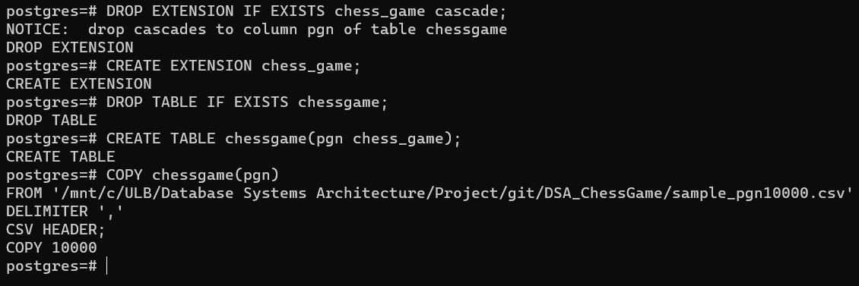
We created extension called chess_game with data type
chess_board
chess_game
Python script was prepared to generate PGN Notation which was later on dumped into table containing field with chess_game data type

Slide 4
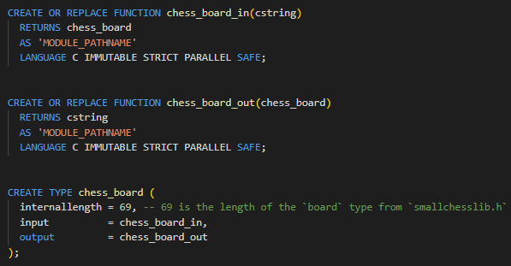
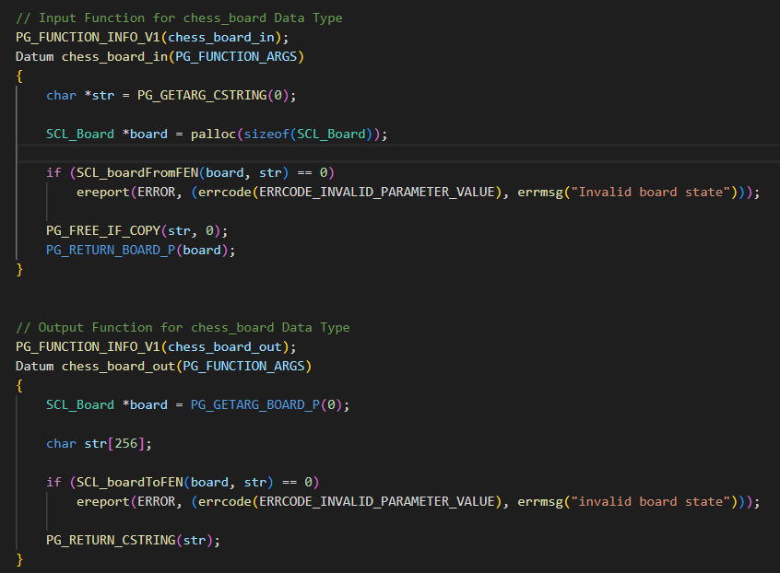
Data Type: Chess Board
SCL_boardFromFEN converts FEN to chess_board data type
SCL_boardToFEN converts chess_board data type to FEN
S
W
T
O

Slide 5
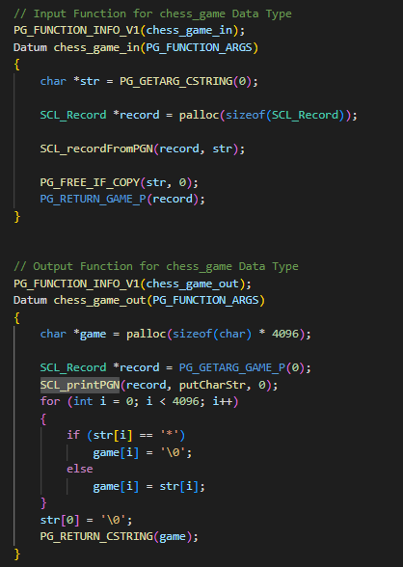
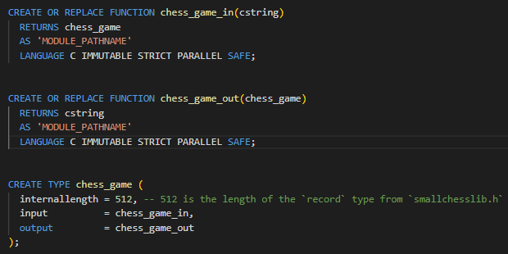
Data Type: Chess Game
SCL_recordFromPGN converts PGN to chess_game data type
SCL_printPGN converts chess_game data type to PGN
S
W
T
O

Slide 6
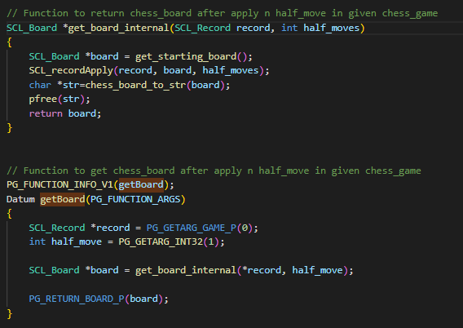
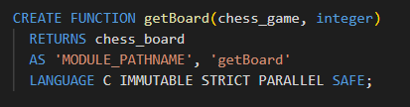
Function: getBoard
getBoard(chessgame, integer) -> chessboard
Returns the board state at a given half-move
SCL_recordApply is used to get board state after applying n half moves in given chess game

Slide 7
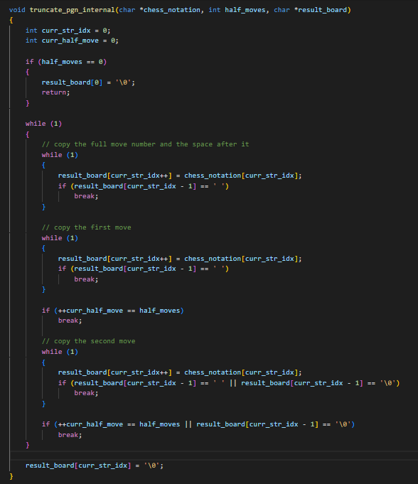
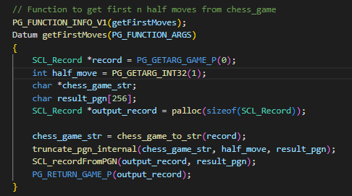

Function: getFirstMoves
getFirstMoves(chessgame, integer) -> chessgame
Returns the chessgame truncated to its first N half-moves
Helper function truncate_pgn_internal extracts subset of chess game, given the number of half moves

Slide 8

Function: hasOpening
hasOpening(chessgame, chessgame) -> boolean
Returns true if the first chess game starts with the exact same set of moves as the second chess game
Logic for this function has been implemented in SQL

Slide 9
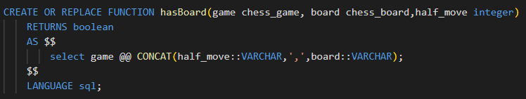
Function: hasBoard
hasBoard(chessgame, chessboard, integer) -> boolean
Returns true if the chessgame contains the given board state in its first N half-moves without considering the move count, castling right, en passant pieces.
Logic for this function has been implemented in SQL

Slide 10
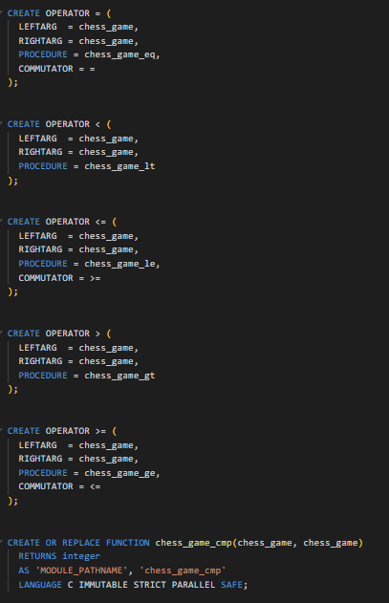
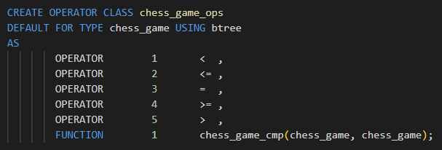
Index: B-Tree
For implementation of B-Tree, we created
five operators <, <=, =, >, >=
five functions to implement above operators
Compare function to compare two chess games

Slide 11
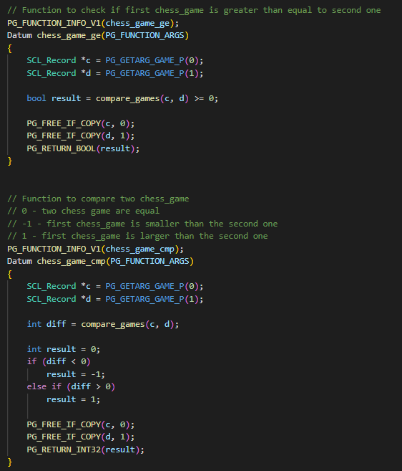
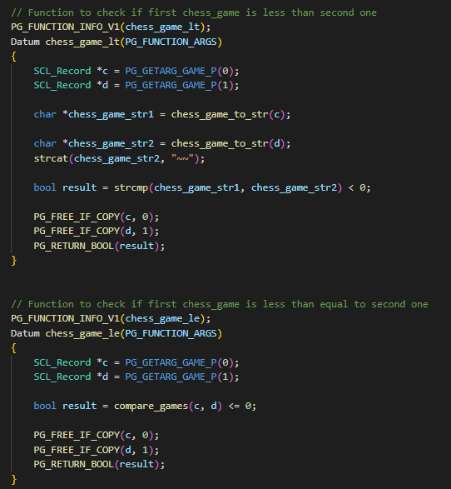
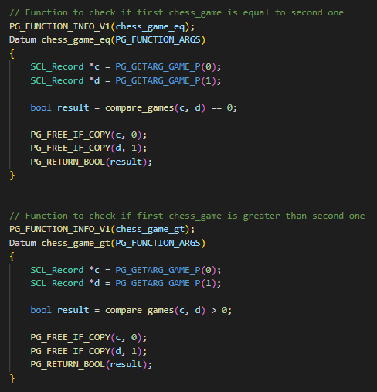
Index: B-Tree

Slide 12
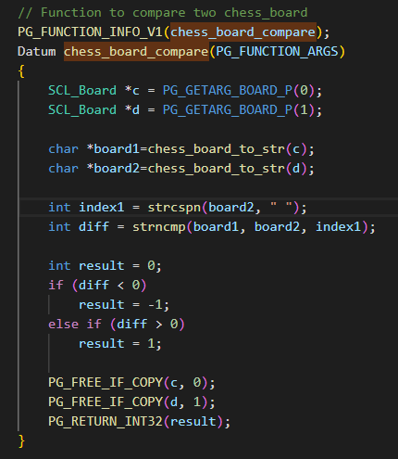
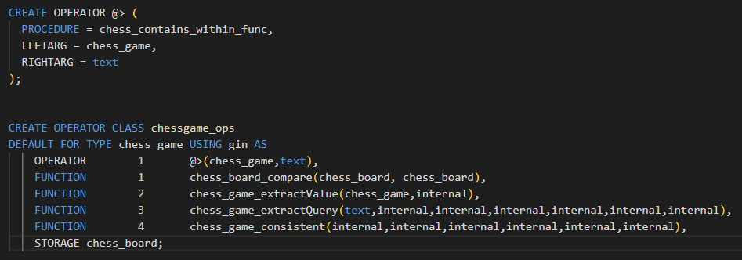
Index: GIN
For implementation of GIN Index, we created
Operator @> which checks if given board state is present in chess game within n half moves
A function to implement @> operator
Compare function to compare two chess boards
Other functions like chess_game_extractValue, chess_game_extractQuery, chess_game_consistent

Slide 13
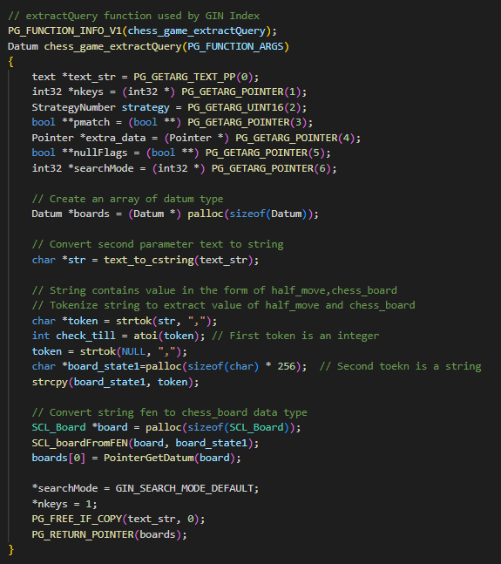
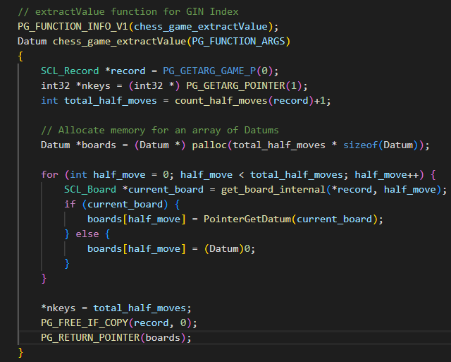
Index: GIN

Slide 14
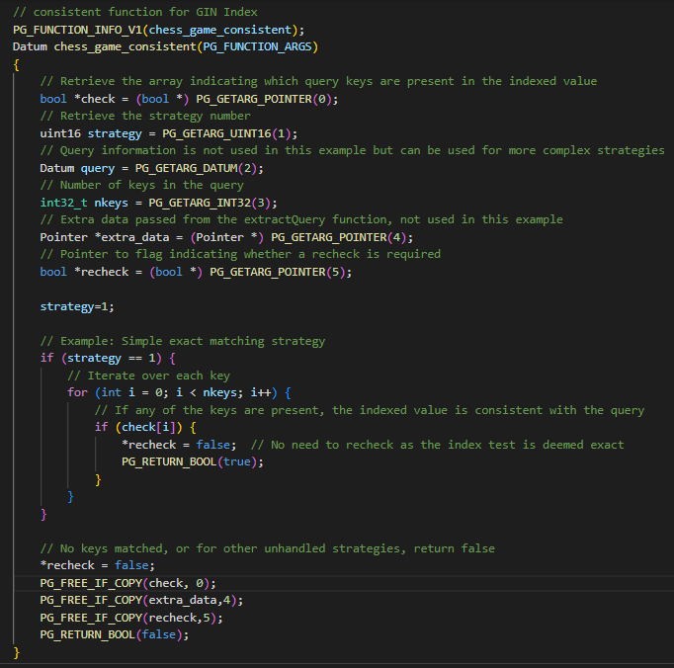
Index: GIN

Slide 15
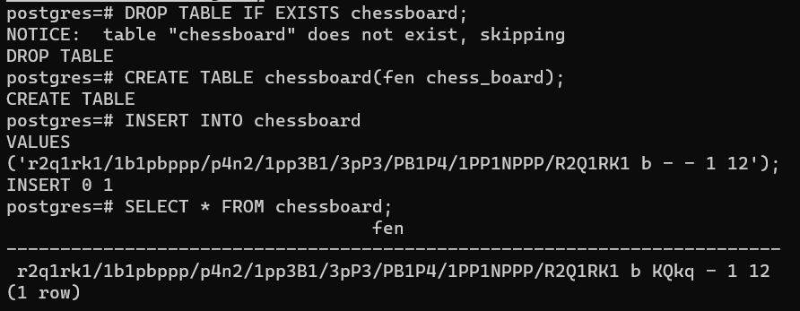
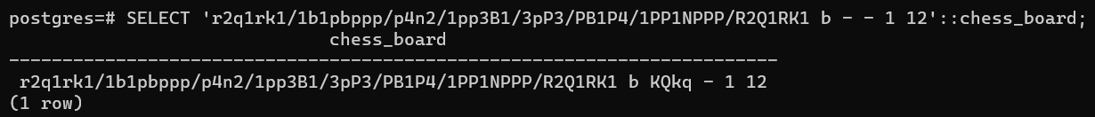
Data Type Validation: Chess Board
Validate creating table with chess_board data type followed by insert and select statement
Validate type cast operation from string to chess_board data type

Slide 16
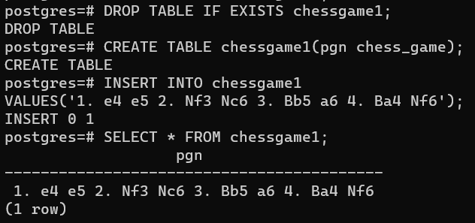
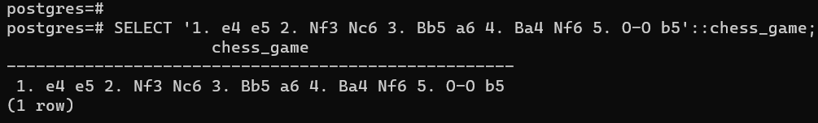
Data Type Validation: Chess Game
Validate creating table with chess_game data type followed by insert and select statement
Validate type cast operation from string to chess_game data type

Slide 17
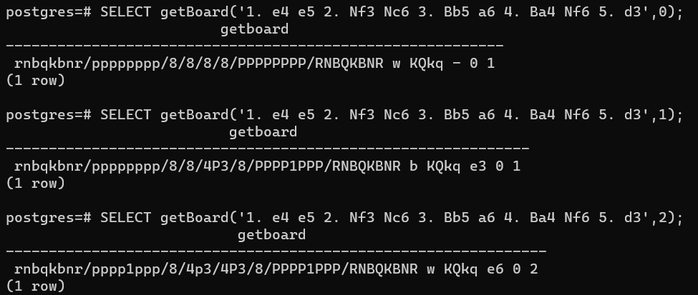
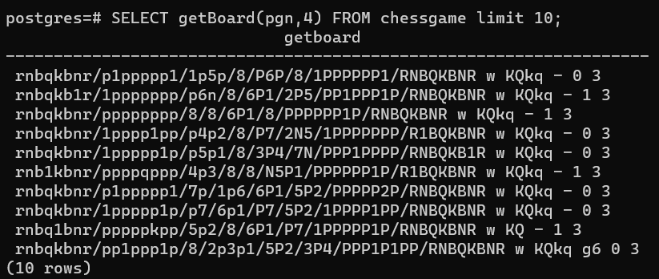
Function Validation: getBoard
Validate if getBoard function is returning correct value for static chess game and number of half moves being passed
Validate if getBoard function can be used to query table containing field with chess game data type

Slide 18
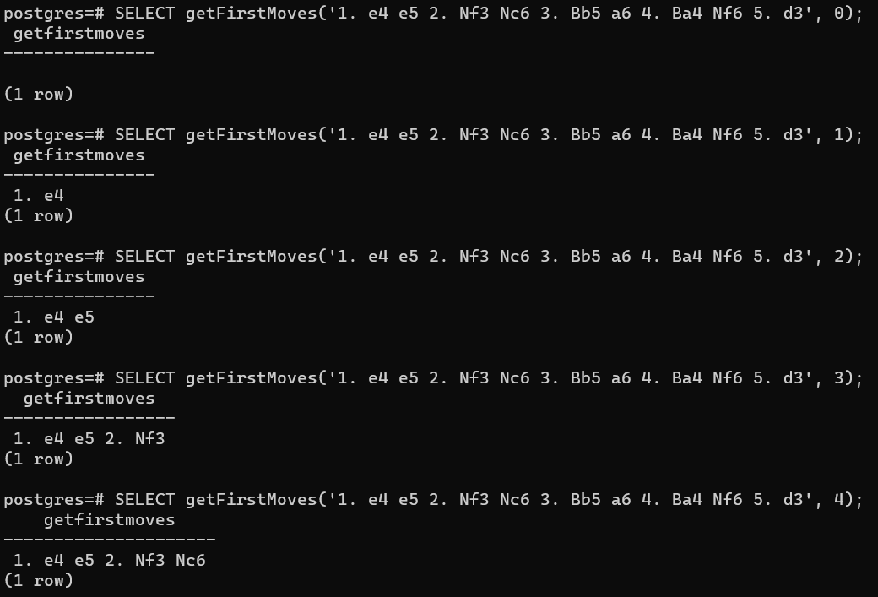
Function Validation: getFirstMove
Validate if getFirstMove function is returning correct value for static chess game and number of half moves being passed
Validate if getFirstMove function can be used to query table containing field with chess game data type

Slide 19
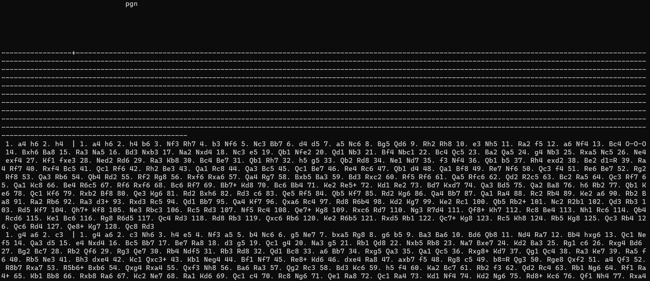

Slide 20
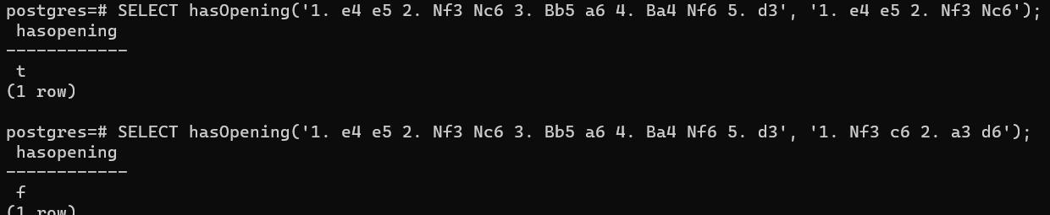
Function Validation: hasOpening
Validate if hasOpening function is returning correct value for static chess games passed.
Validate if hasOpening function can be used to query table containing field with chess game data type.

Slide 21
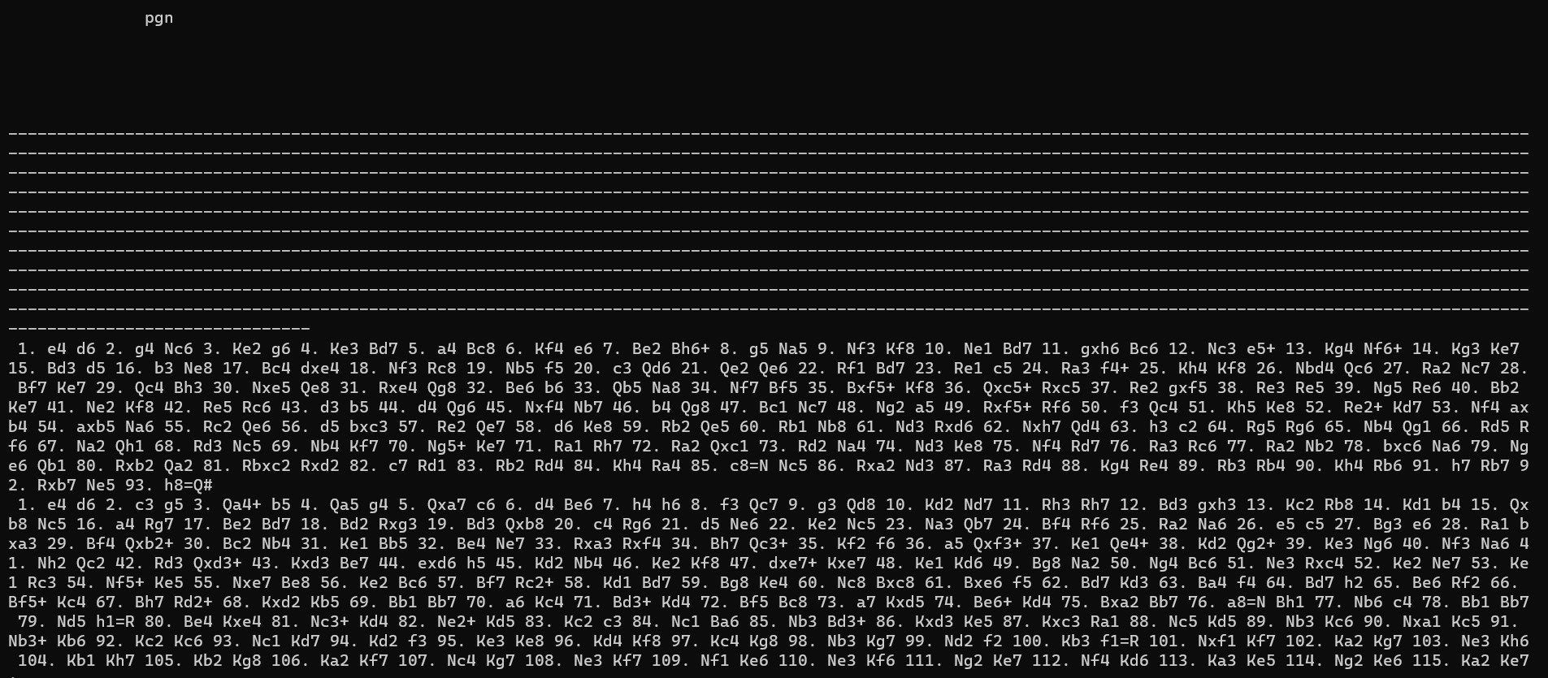
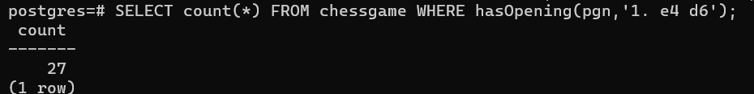

Slide 22
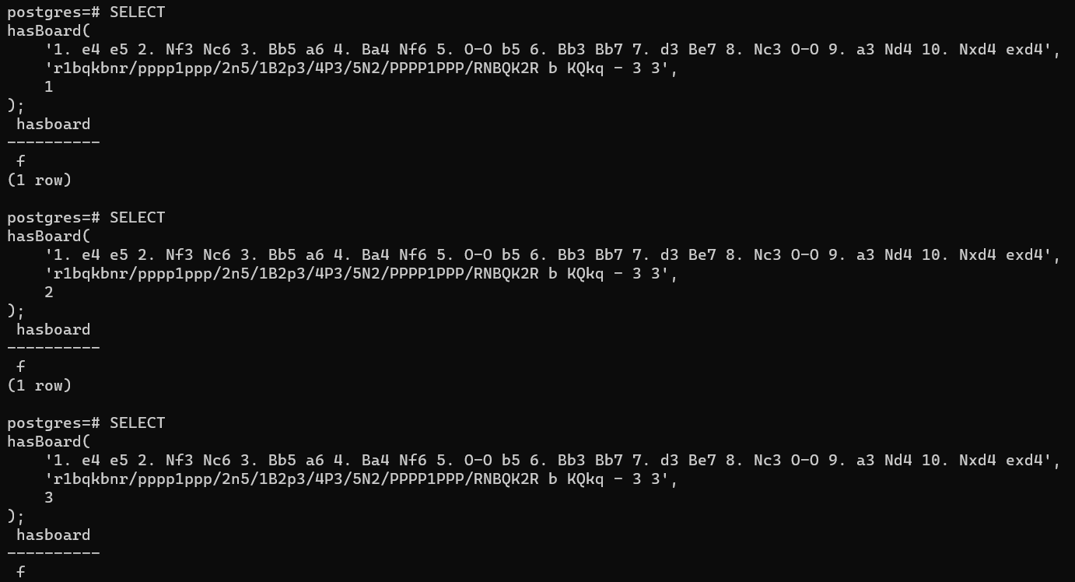
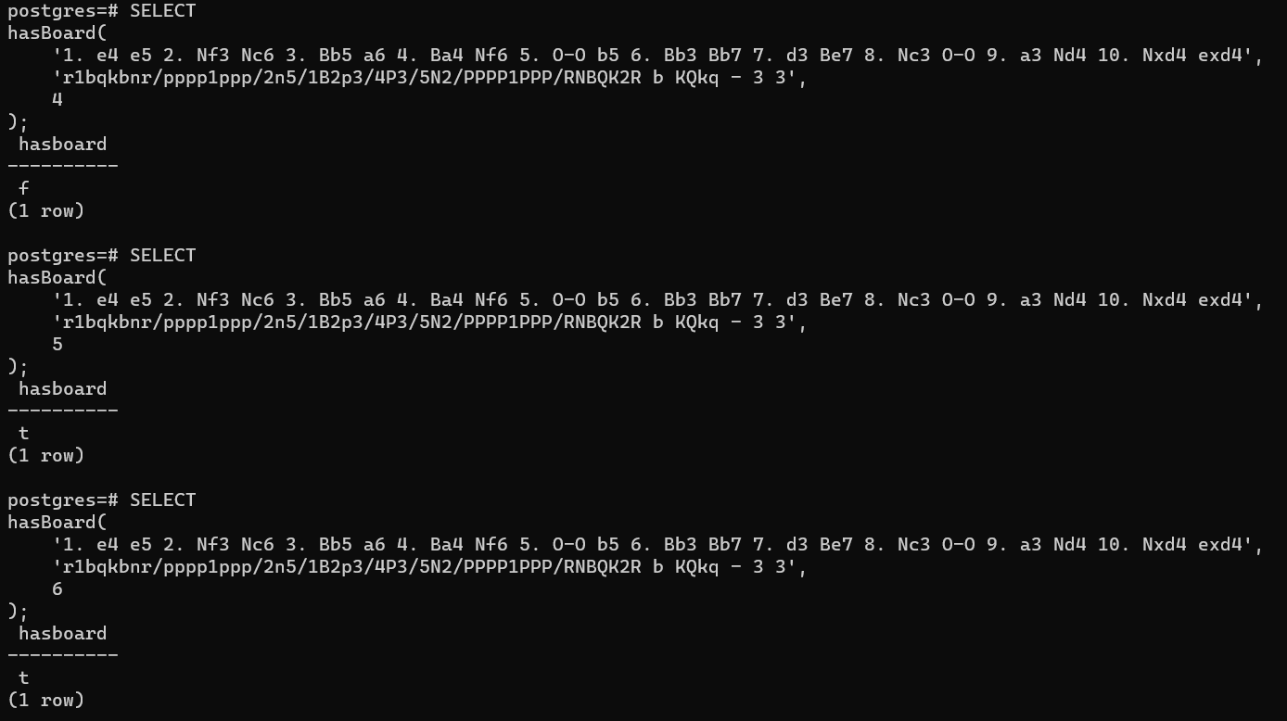
Function Validation: hasBoard
Validate if hasBoard function is returning correct value for static chess game, chess board and number of half moves passed
Validate if hasBoard function can be used to query table containing field with chess game data type
Confirm that only chess board state should be considered

Slide 23
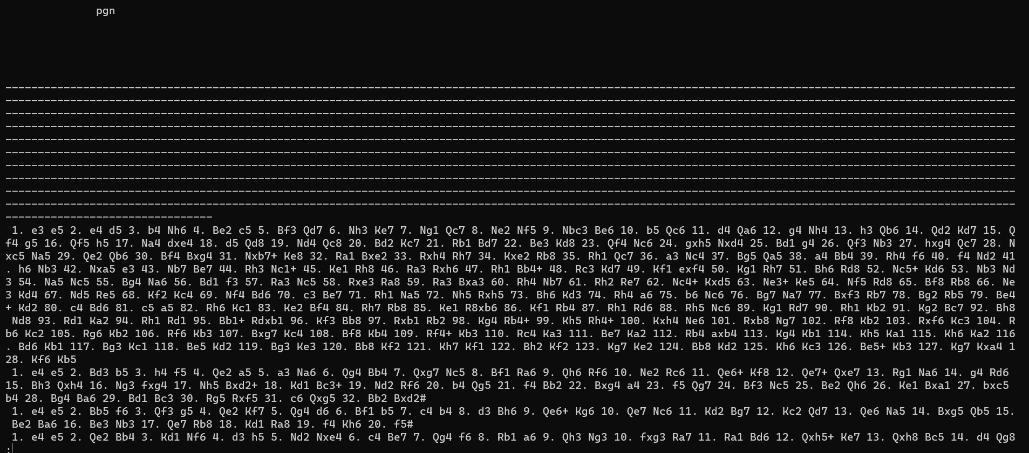

Slide 24
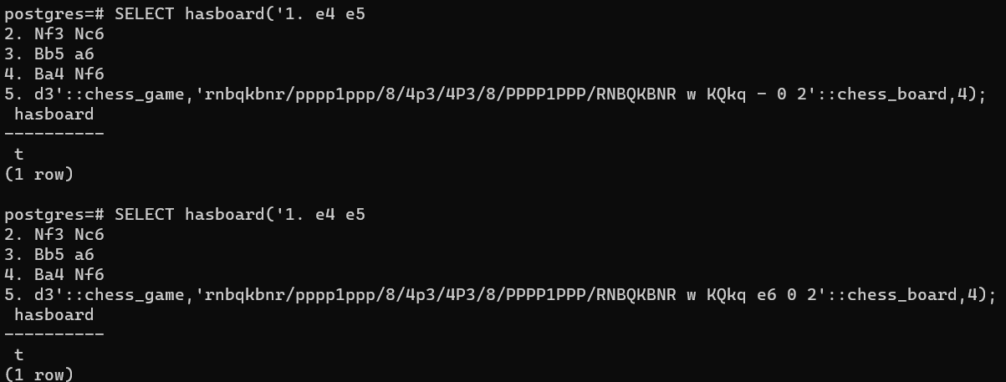

Slide 25
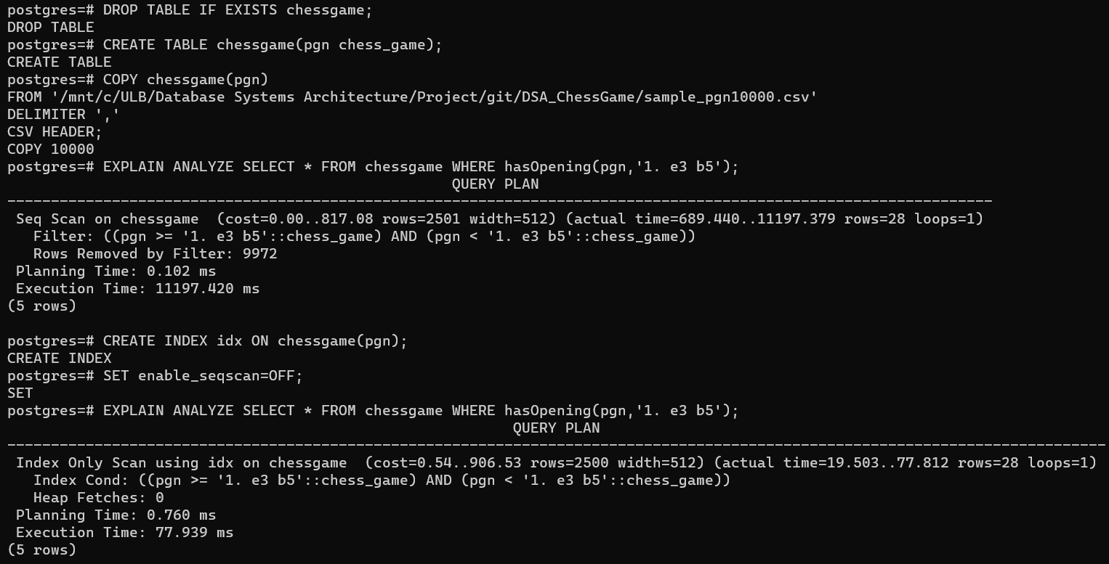
Index Validation: B-Tree
Validate if we are able to create B-Tree index on chess_game datatype
Validate if B-Tree index is being picked by hasOpening function

Slide 26
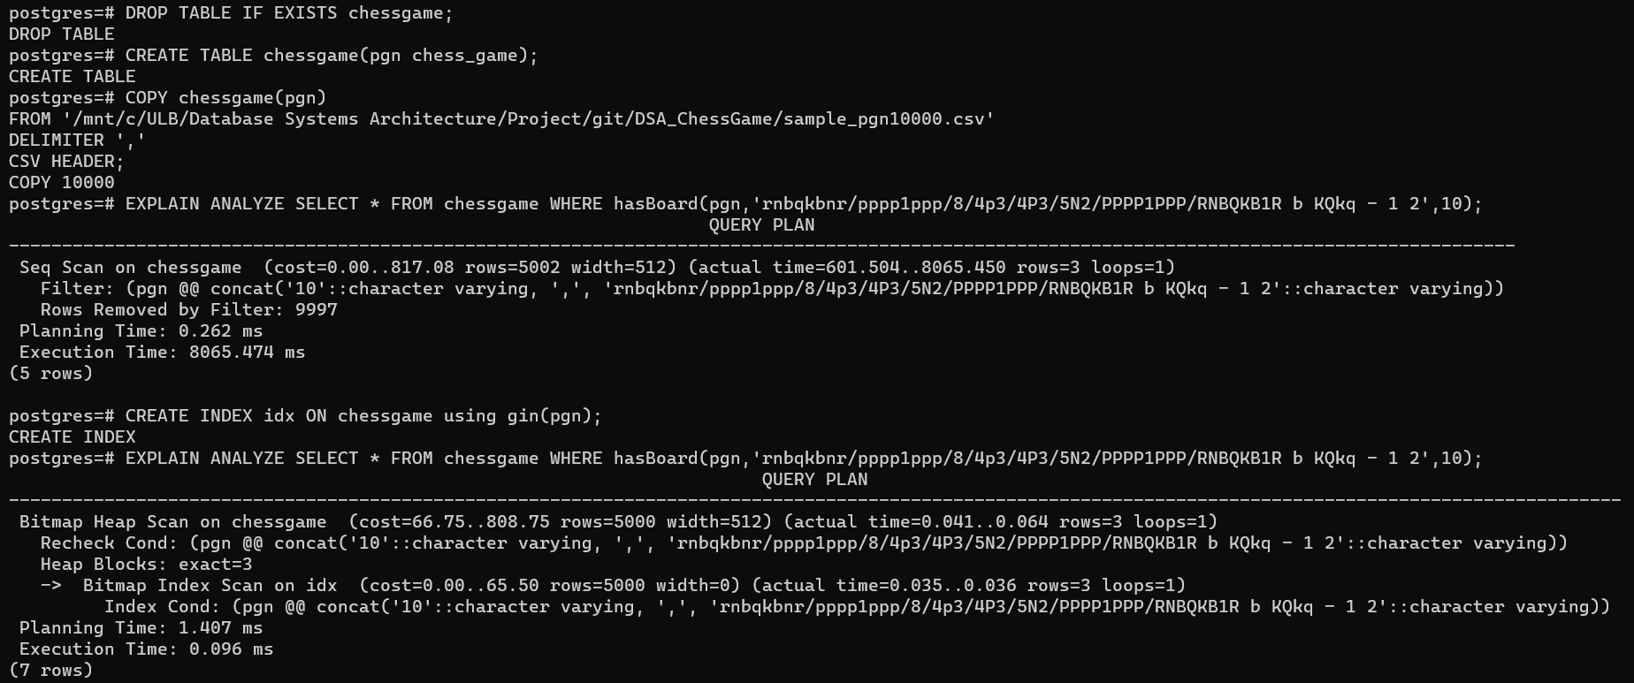
Index Validation: GIN
Validate if we are able to create GIN index on chess_game datatype
Validate if GIN index is being picked by hasBoard function

Slide 27
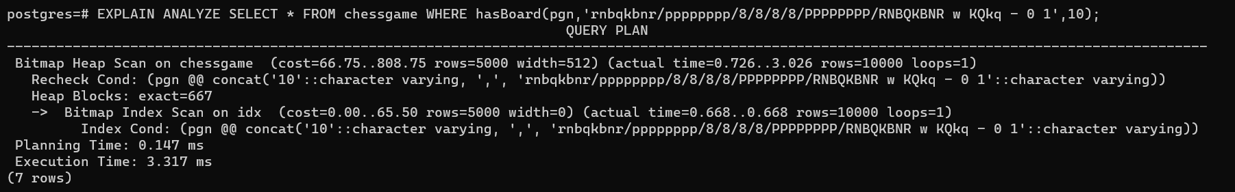

Slide 28
Important Links
Githubme/tree/main
https://github.com/SonyShrestha/DSA_ChessGame
Test Cases
https://github.com/SonyShrestha/DSA_ChessGame/blob/main/sql_files/test_script.sql

Slide 29
THANK YOU

